Slide 1
MOTIVE
To send and receive real time data using eventhub and databricks.

Slide 2
TOOLS USED
AZURE
PYTHON
EVENT HUBS
DATABRICKS
TWITTER DEVELOPER ACCOUNT

Slide 3
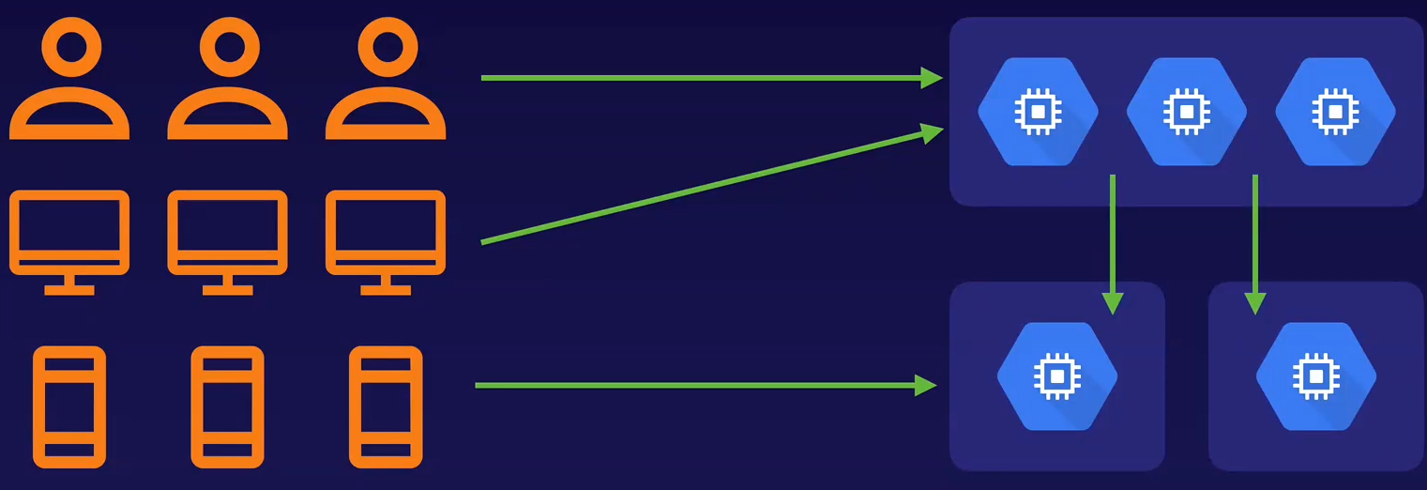
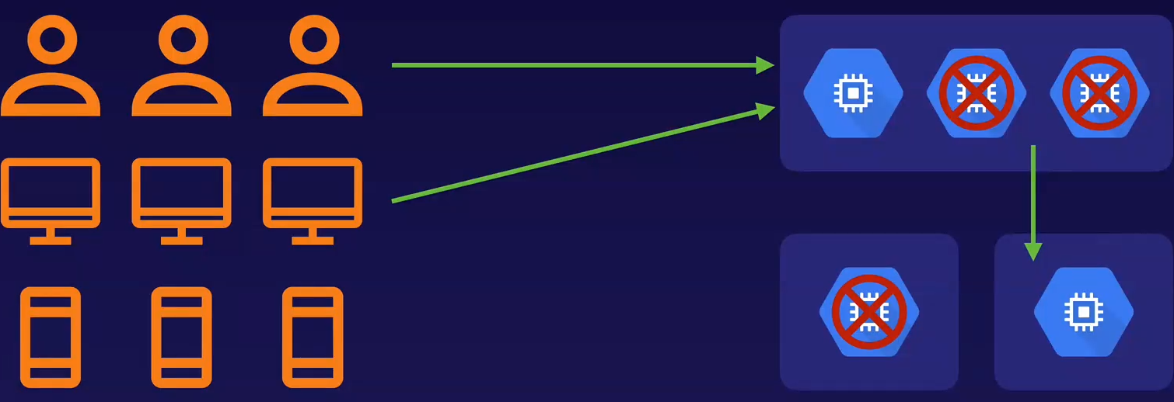
EVENT HUB – WHY ?

Slide 4
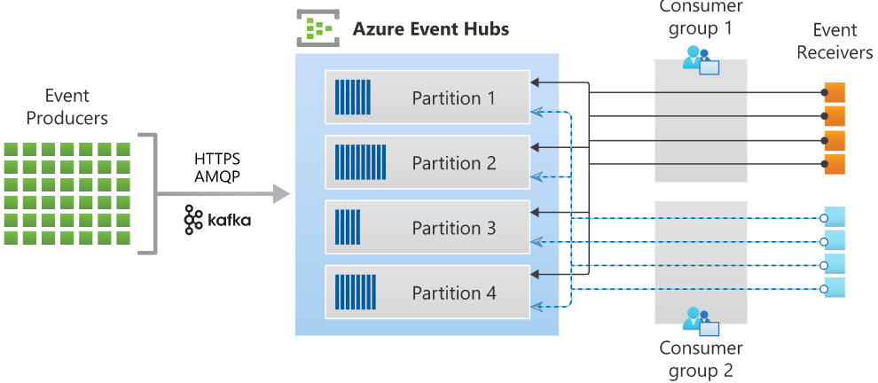
What is Event Hub ?
Event Hubs is a fully managed Platform-as-a-Service (PaaS)
Event Hubs represents the "front door" for an event pipeline
Available in various languages .NET, Java, Python, JavaScript
Architecture:

Slide 5
AZURE DATABRICKS – WHY ?
Optimized spark engine
Scalability
Cost effective
Enterprise-grade security
Languages - Python, Scala, R, Spark SQL and .Net
Machine learning run time
Fully Managed

Slide 6
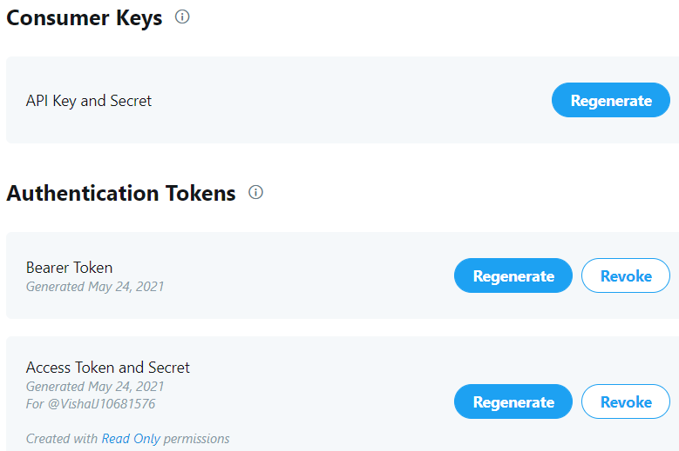
CONFIGURATION

Slide 7
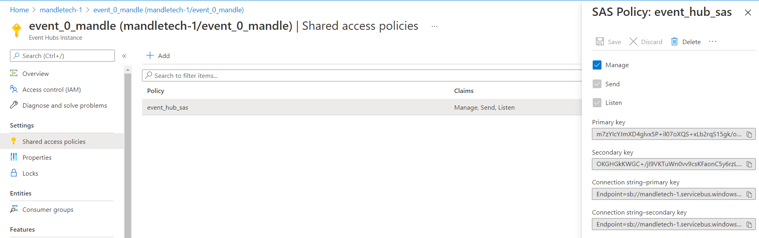
CONFIGURATION

Slide 8
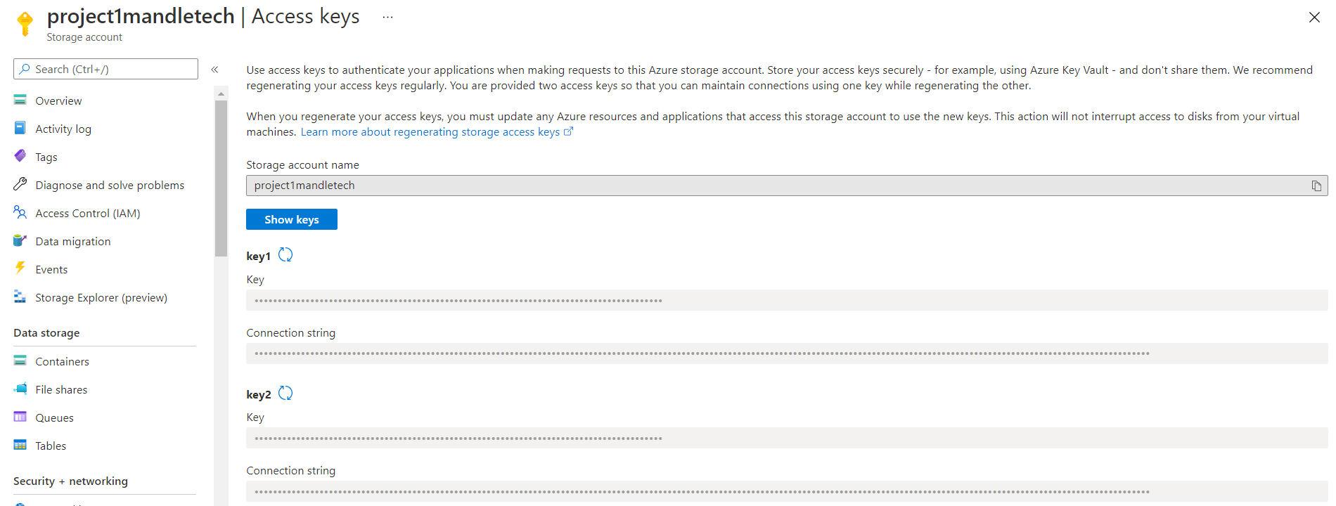
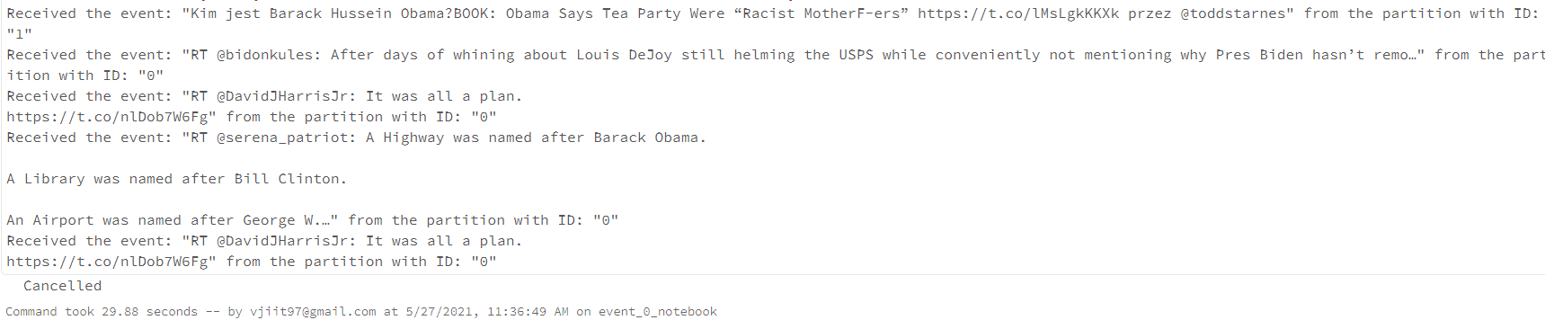
CONFIGURATION

Slide 9
THE END

